Slide 1
Data Structures

Slide 2
Lowest Common Ancestor in a Binary Tree

Slide 3
Lowest Common Ancestor in a BST

Slide 4
Left View of a Binary Tree

Slide 5
Left View of a Binary Tree - Iterative

Slide 6
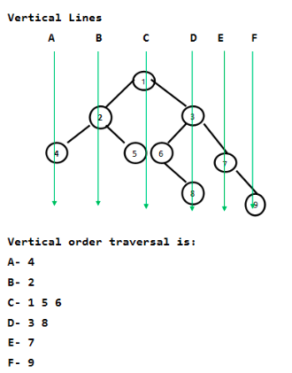
Vertical Traversal of a Binary Tree

Slide 7
THANK YOU

